Slide 1
Prog8470 Mobile application Development- iOS

Slide 2
Slide & score
By:
Saj Panchal
Neel Patel
Nandan Shah
Ruchit Shah

Slide 3
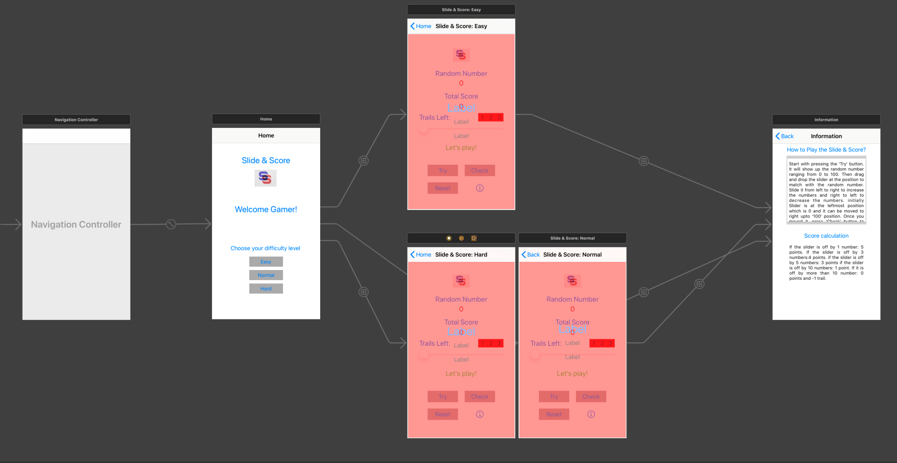
Screen navigation
Home Screen
Play Screen: Easy
Play Screen: Normal
Play Screen: Hard
Information Screen

Slide 4
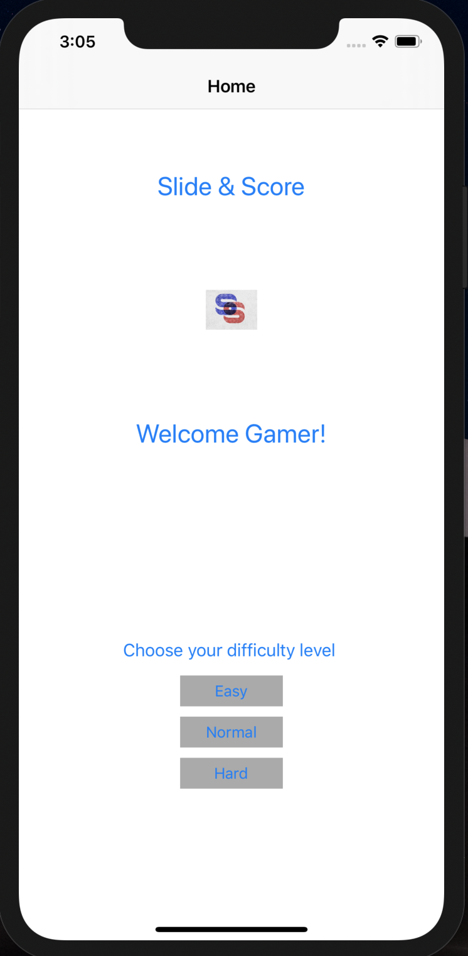
HOME SCREEN
Select difficulty levels:
Easy (slider with values 0-100)
Normal (slider with values 0-200)
Hard (slider with values 0-500)

Slide 5
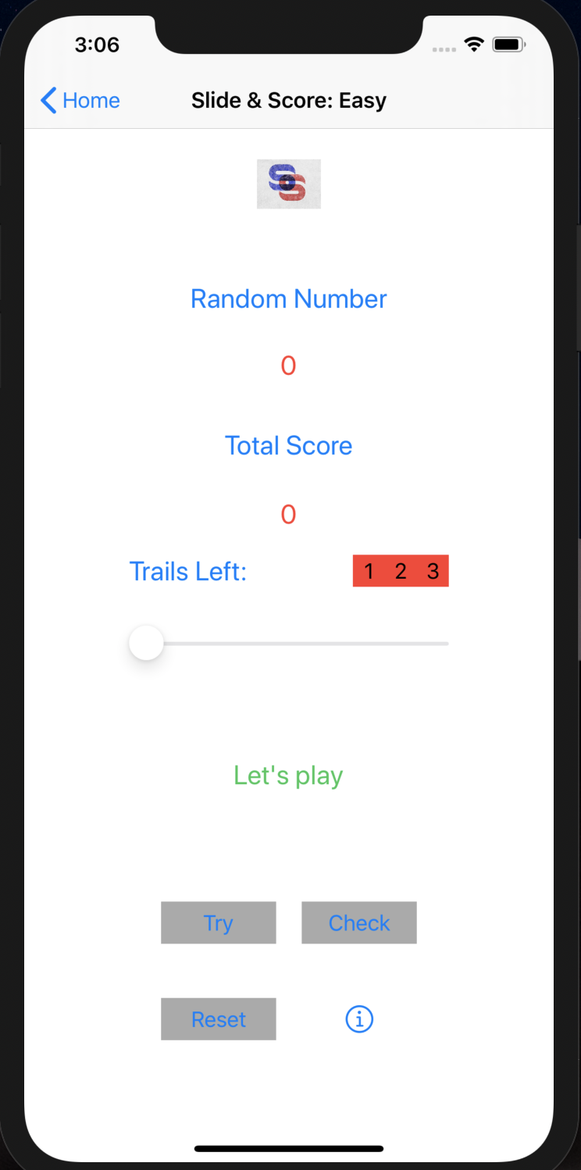
Game play screen
Info page link
Try and check buttons
Slider
Random number
Total score
game trails
Reset button
Message label

Slide 6
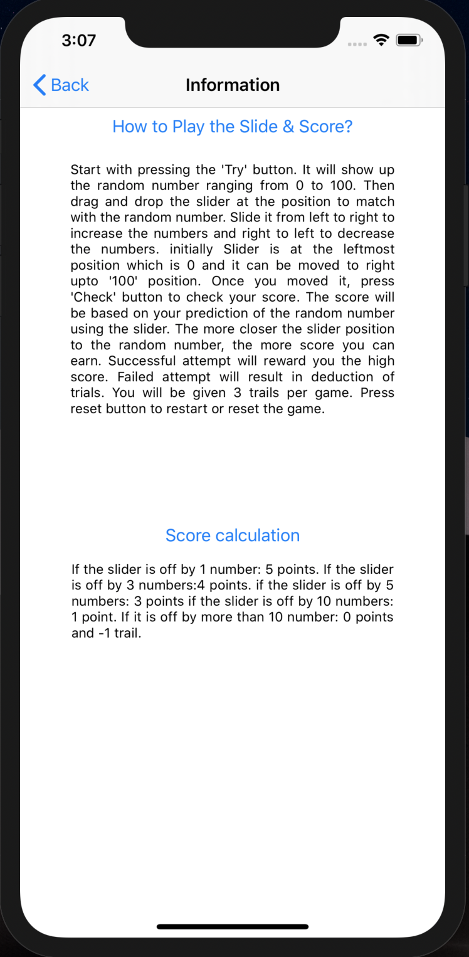
Information Screen
How to play? (scroll view)
Score calculation

Slide 7
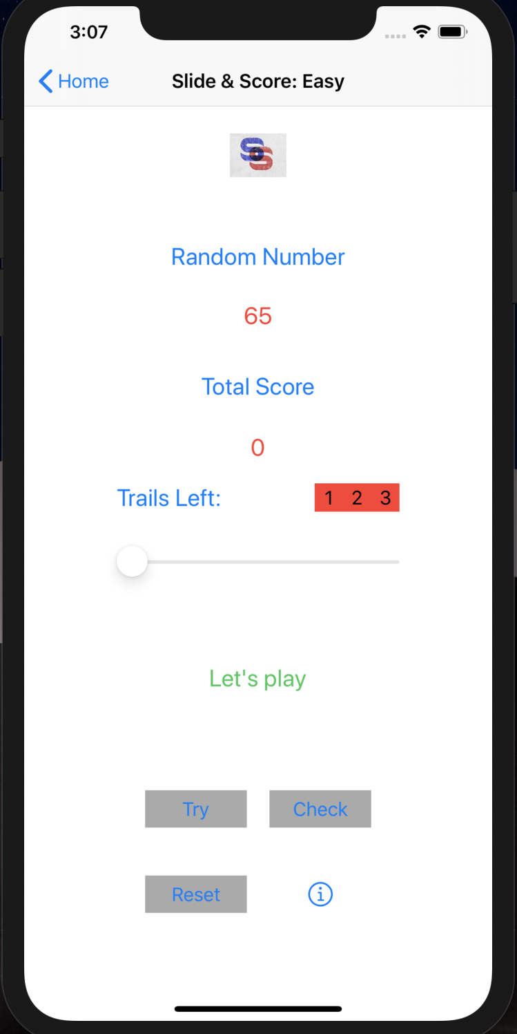
How to play the game?
Step 1:
Click on try button.
It will generate a random number.

Slide 8
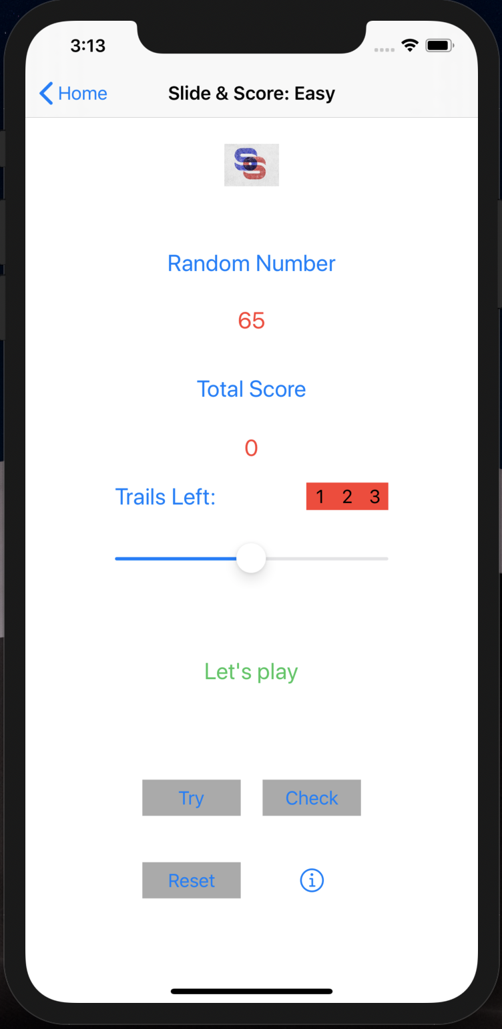
How to play the game?
Step 2:
Drag and drop the slider to match with the random number

Slide 9
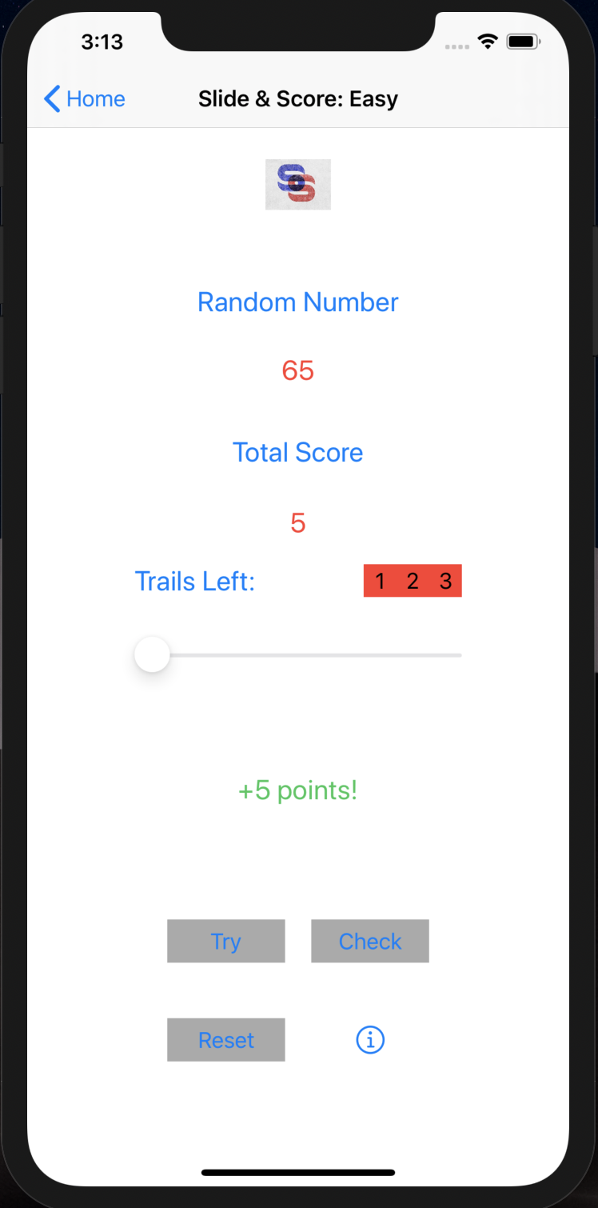
How to play the game?
Step 3:
Click on check button and it will update the total score.
The message will display you have scored 5 points for the correct guess.

Slide 10
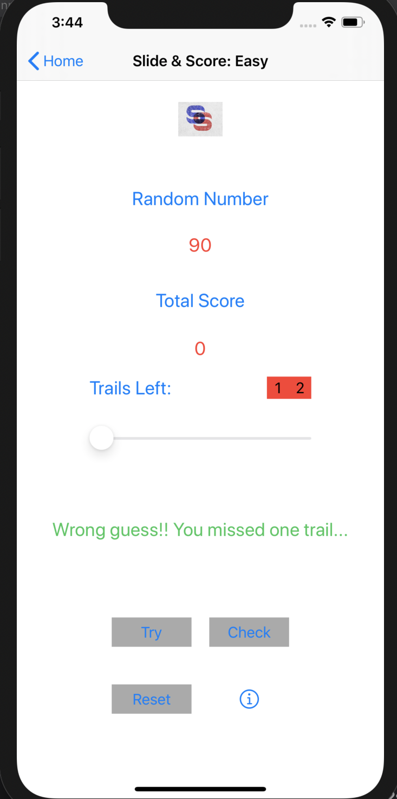
How to play the game?
For a wrong guess 1 out of 3 trails will be deducted.

Slide 11
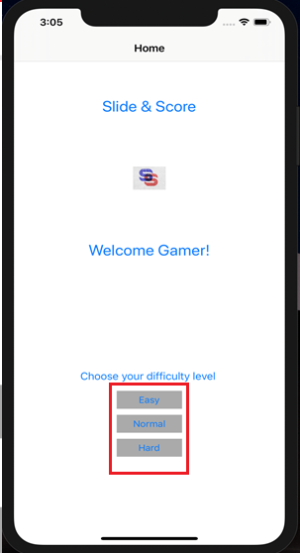
ADDITIONAL FEATURE
(Feature #1)
Game can be played in 3 difficulty levels: Easy, Normal and Hard

Slide 12
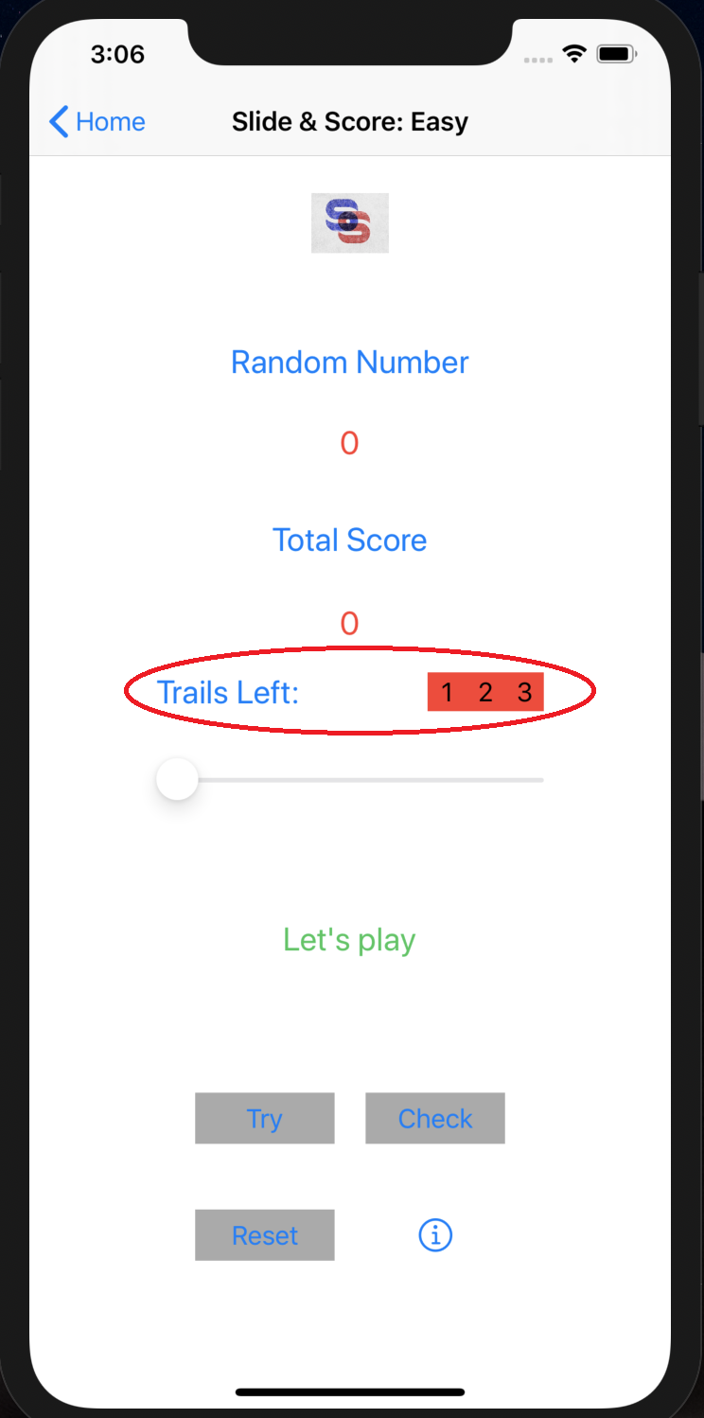
Additional features
(Feature #2)
Allowing players to give 3 trails per game if fails.

Slide 13
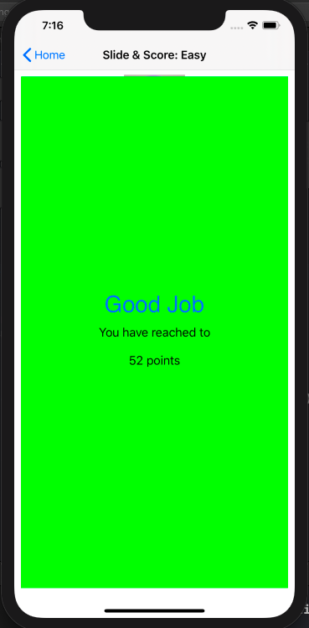
Additional features
(Feature #3)
Upon crossing each 50s milestone a screen pop up view will be displayed for 3 secs with greetings and total points.
(Feature #4)
Appropriate notification sound will also be generated along with it.

Slide 14
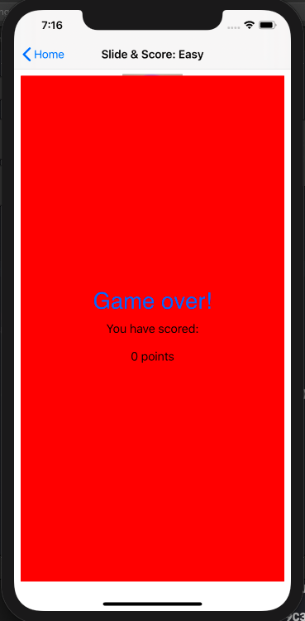
Additional features
(Feature #3)
If you loose all trails game over pop up view will be displayed for 3 secs.
(Feature #4)
Appropriate notification sound will also be generated along with it.

Slide 15
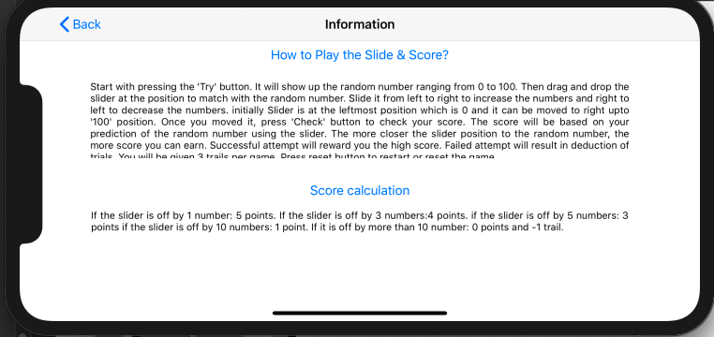
ADDITIONAL FEATURES
(Feature #5)
In info page, ’How to Play the Slide & Score’ section consists of scroll view to fit the whole content.

Slide 16
FUTURE Considerations
We are planning to add more graphics, animation and Sounds.
We are also planning to add user to login, record high scores and share scores to social media platforms.

Slide 17
Thank You!

